Slide 1
Hand-Written Digits Recognition

Slide 2
Purpose of choosing the task
To gain understanding how classification models run on MNSIT dataset.
To classify handwritten numbers using various algorithms.
To compare various algorithms to see who gives the best accuracy.

Slide 3
Agenda/Objective
To classify hand-written digits using various supervised classification machine learning algorithms.
Comparing various classification models to see which one gives the best accuracy.
The classification algorithms used to detect the hand-written digits are KNN,
Decision tree and Random Forest.

Slide 4
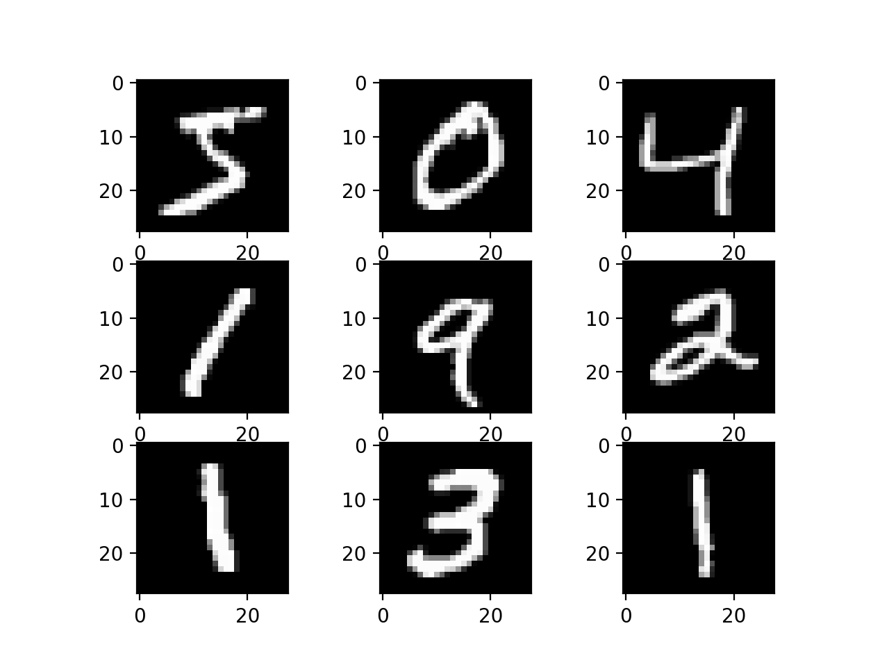
Description of the dataset
Source of the dataset is Kaggle.
Name of the dataset is MNIST.
MNIST is a set of 70,000 small images of digits handwritten by high school students and employes of the US Census Bureau.
All images are labelled with respective digit they represent.
MNIST is a hello world program of machine learning.
There are 70,000 images, and each image has 784 features.
Each image is 28x28 pixels, and each feature simply represents one pixel’s intensity 0(white) to 255 (black)
Hand-Written Digits
Images

Slide 5
Steps performed in the task
Data Collection
Data Preprocessing Steps
Checking for null values
Handling missing values
Encoding the categorical column
Splitting into x and y variables
Splitting the dataset into training and testing set.
Applied different classification models to the dataset.
Checked the accuracy for each of these models using evaluation metrics as precision, Recall, F1 score .

Slide 6
Algorithms used in the task
KNN
Decision Tree
Random Forest
K-nearest neighbor to classify similar data into groups using the Euclidean distance.
Decision Tree is a supervised learning model.
It has a tree- like structure
Takes decision based on the if-else like statement. The components of the tree are root node, leaf node, decision node
It is another supervised
machine learning
algorithm
Take multiple trees into
account to take
decision
Overcomes the problem
of overfitting

Slide 7
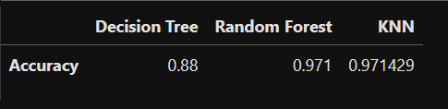
Conclusion
As seen above Decision Tree completed instantly with 88 % accuracy , Random Forest with 97 % accuracy with very less running time and KNN with 97 % accuracy with considerable running time and occupying the resources all along .

Slide 9

01
Introduction
Insert a subtitle here if you need it

Slide 10
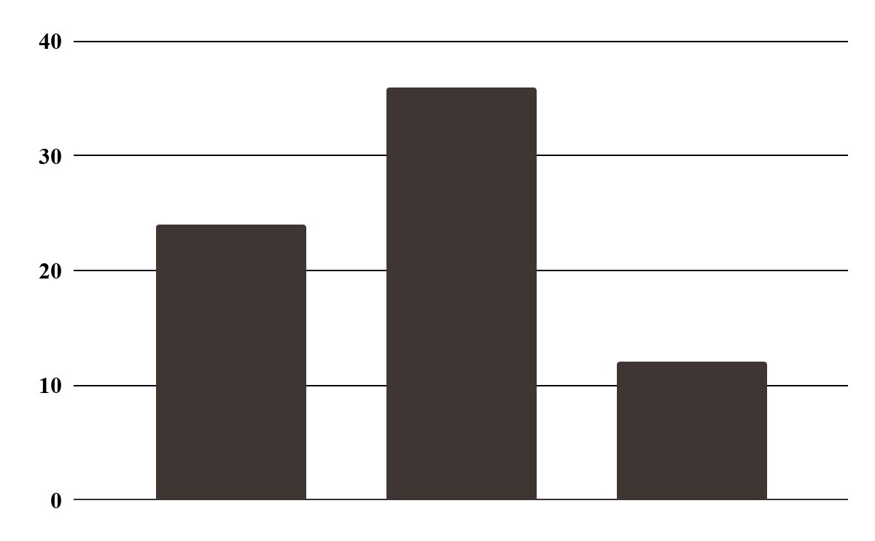
This is a graph
Jupiter
It’s a gas giant and the biggest planet
Venus
Venus has a beautiful name
Mars
Jupiter
Venus
Mars
Mars is a cold place, not hot
Follow the link in the graph to modify its data and then paste the new one here. For more info, click here

Slide 11
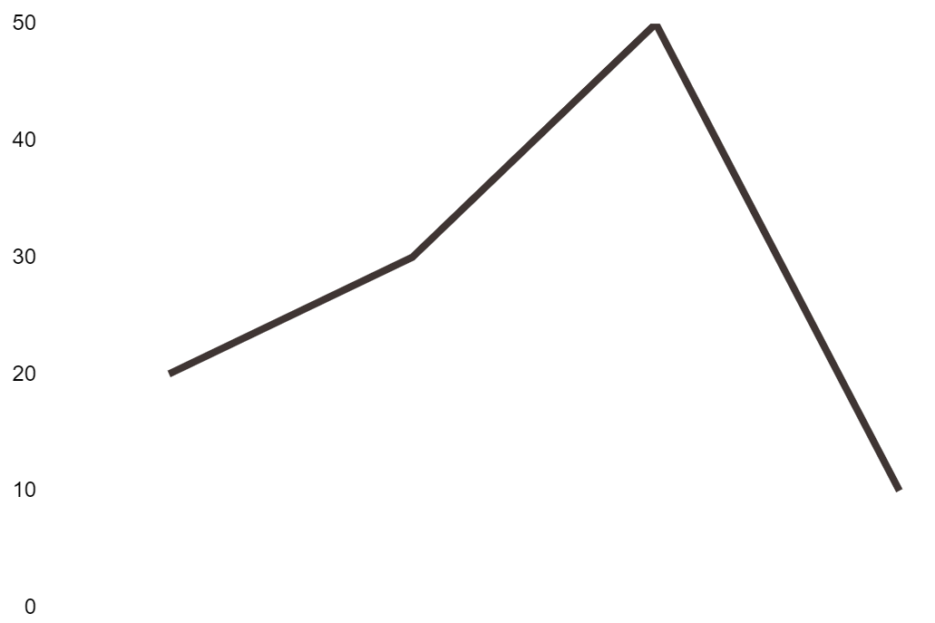
This is a graph
20% Mars
Mars is a cold place, not hot
30% Jupiter
Jupiter is the biggest planet
50% Venus
Venus has a beautiful name
Jupiter
Mars
Venus
Follow the link in the graph to modify its data and then paste the new one here. For more info, click here

Slide 12
Maybe you need to divide the content
Mercury
Venus
Mercury is the closest planet to the Sun and the smallest one
Venus has a beautiful name and is the second planet from the Sun

Slide 13

Maybe you need to divide the content
Mercury
Venus
Mercury is the closest planet to the Sun
Venus has a beautiful name and it’s hot
Jupiter
Mars
It’s a gas giant and the biggest planet
Despite being red, Mars is actually a cold place

Slide 14

A picture is worth a thousand words

Slide 15

A picture is worth a thousand words

Slide 16
145,245
Big numbers catch your audience’s attention

Slide 17
795,321
Big numbers catch your audience’s attention

Slide 18
Schedule
Phase 1
9:00
10:00
11:00
12:00
Task 1
Task 2
Phase 2
Task 1
Task 2

Slide 19
Schedule
 | Monday | Tuesday | Wednesday | Thursday | Friday
08:15 | Task 1 | Meeting | Idea | Project | Test
10:20 | Meeting | Idea | Task 3 | Chat | Task 4
12:15 | Proposal | Meeting | Meeting | Idea | Idea
14:30 | Test | Task 2 | Project | Test | Meeting

Slide 20

02
Company
Insert a subtitle here if you need it

Slide 21

Company
02
Insert a subtitle here if you need it

Slide 22
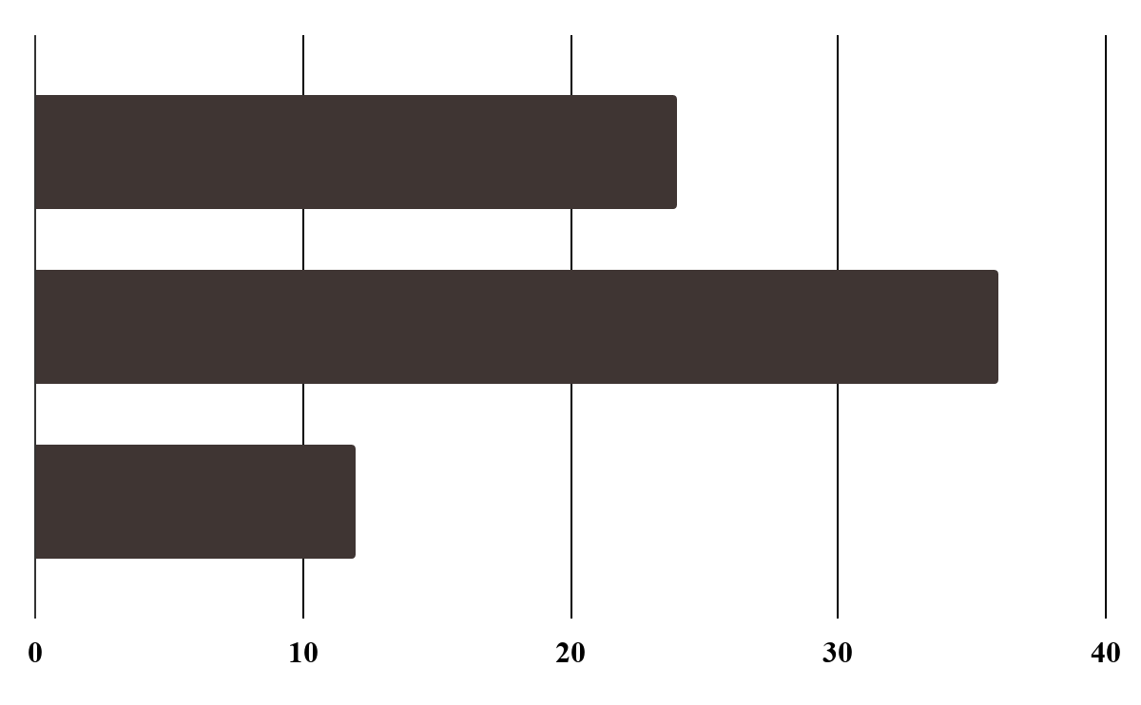
This is a graph
1,254
4,215
8,554
Jupiter
It’s a gas giant and the biggest planet
Jupiter
Venus
Venus
Venus has a beautiful name
Mars
Mars
Mars is a cold place, not hot
Follow the link in the graph to modify its data and then paste the new one here. For more info, click here

Slide 23
More graphs
35% Jupiter
20% Mars
Jupiter is the biggest planet
Mars is a cold place, not hot
10% Venus
35% Mercury
Venus has a beautiful name
Mercury is the smallest planet

Slide 24
Target
Gender
Age
30%
50%
20%
70%
30%
18 - 25
26 - 35
+36

Slide 25
Target
Most selled products
Gender
Write the best-selling products
Write the best-selling products
Write the best-selling products
Write the best-selling products
Write the best-selling products
60%
Saturn is a gas giant and has rings
40%
Annual expenses
Mercury is the closest planet to the Sun
Avg. expense: $5000
Age
25-38
39-50

Slide 26

A picture always reinforces
the concept
Images reveal large amounts of data, so remember: use and image instead of long texts

Slide 27

A picture always reinforces
the concept
Images reveal large amounts of data, so remember: use and image instead of long texts

Slide 28
You can use six columns
Mercury
Venus
Mars
It’s the closest planet to the Sun
It’s a planet with very high temperatures
Mars is actually a very cold place
Jupiter
Saturn
Neptune
Jupiter is the biggest planet of them all
It’s composed of hydrogen and helium
It’s the farthest planet from the Sun

Slide 29
This is a timeline
Jupiter
Mars
Jupiter is the biggest planet
Mars is a cold place, not hot
01
02
03
04
Mercury
Neptune
Mercury is the smallest planet
Neptune is far away from Earth

Slide 30
How the company generates income
Mercury
Mars
Saturn
Mercury is a small planet
Mars is actually very cold
Saturn is a gas giant with rings
Jupiter
Neptune
Jupiter is the biggest planet
Neptune is far away from Earth

Slide 31
This is a table
 | Mars | Venus | Jupiter
Task 1
Task 2
Task 3
Task 4

Slide 32
This is a table
 | Task 1 | Task 2 | Task 3 | Task 4
Description | Jupiter is the biggest planet | Mercury a small planet | Saturn has several rings | Neptune is far away from us
Year | 2019 | 2020 | 2021 | 2022
Duration | Three months | Two weeks | Six months | Four months

Slide 33
Percentages
20%
40%
60%
Mars
Venus
Mercury
Mars is actually a cold place
Venus has a beautiful name
Mercury is the smallest planet

Slide 34
Percentages
40%
60%
Mercury
Mars
Mercury is the smallest planet
Mars is actually a very cold place

Slide 35
You can use six columns
Mars
Venus
Mercury
Mars is actually a cold place
Venus has a beautiful name
Mercury is the smallest planet
Neptune
Jupiter
Saturn
Neptune is far away from Earth
Jupiter is the biggest planet
Saturn is a gas giant with several rings

Slide 36
Competitors
Mars
Mercury
Jupiter
Despite being red, Mars is cold
Mercury is the smallest planet
Jupiter is the biggest planet
Neptune
Saturn
Neptune is far away from Earth
Saturn is a gas giant with rings

Slide 37
Awesome words

Slide 38
Awesome words

Slide 39
This is a map
Jupiter
Venus
It’s a gas giant and the biggest planet
Venus has a beautiful name
Mars
Mercury
Mars is a cold place, not hot
Mercury is the smallest planet

Slide 40
This is a map
Jupiter
Mars
Jupiter is the biggest planet
Mars is a cold place, not hot
Venus
Mercury
Venus has a beautiful name
Mercury is the smallest planet

Slide 41
You can use four columns
Mars
Venus
Mars is actually a cold place
Venus has a beautiful name
Neptune
Jupiter
It’s the farthest planet from the Sun
Jupiter is the biggest planet

Slide 42
You can use three columns
01
02
03
Neptune
Mars
Jupiter
Neptune is far away from Earth
Mars is actually a cold place
Jupiter is the biggest planet

Slide 43
This is an infographic
Mars
Venus
01
02
Mars is a cold place, not hot
Venus has a beautiful name
Jupiter
Saturn
03
04
Jupiter is the biggest planet
Saturn is a gas giant with rings

Slide 44
This is an infographic
Mercury
Venus
Idea
Product
Mars
Mercury is the closest planet to the Sun
Venus is the second planet from the Sun
Despite being red, Mars is actually a cold place

Slide 45
Monthly data
125K
250K
540K
January
June
November
Mars is actually a cold place
Venus has a beautiful name
Mercury is the smallest planet

Slide 46
Percentages
25%
20%
40%
15%
Venus
Jupiter
Venus has a beautiful name and it's very hot
Jupiter is the biggest planet of them all
Mars
Neptune
Despite being red, Mars is actually a cold place
It’s the farthest planet from the Sun

Slide 47
Our goals
Mars
Venus
Mars is actually a cold place
Venus has a beautiful name
Neptune
Jupiter
It’s the farthest planet from the Sun
Jupiter is the biggest planet

Slide 48

Our goals
Neptune
It’s the farthest planet from the Sun
Venus
Venus has a beautiful name
Jupiter
Jupiter is the biggest planet

Slide 49
Statistics
 | Phase 1 | Phase 2 | Phase 3
Mercury | 1,254 | 9,145 | 8,145
Mars | 5,214 | 6,541 | 3,214
Saturn | 3,418 | 3,214 | 5,415

Slide 50
Statistics
 | 2019 | 2020 | 2021 | 2022
Avg. spen | $15,225 | $40,000 | $45,000 | $65,000
Description | Mercury is very small | Venus has a nice name | Jupiter is the biggest planet | Mars is a cold place, not hot
Customers | 12,000 | 20,000 | 19,000 | 40,000

Slide 51
9h 55m 23s
333,000
386,000 km
Jupiter’s rotation period
The Sun’s mass compared to Earth’s
Distance between Earth and the Moon

Slide 52
354
789
912
Mars
Despite being red, Mars is actually a cold place
Mercury
Mercury is the smallest planet of them all
Neptune
Neptune is the farthest planet from the Sun

Slide 53

Desktop mockup
You can replace the image on the screen with your own work

Slide 54
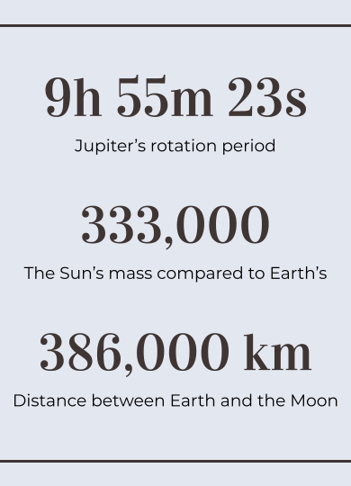
Tablet app
You can replace the image on the screen with your own work

Slide 55
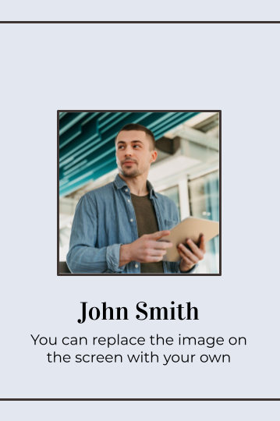
Mobile web
You can replace the image on the screen with your own work

Slide 56
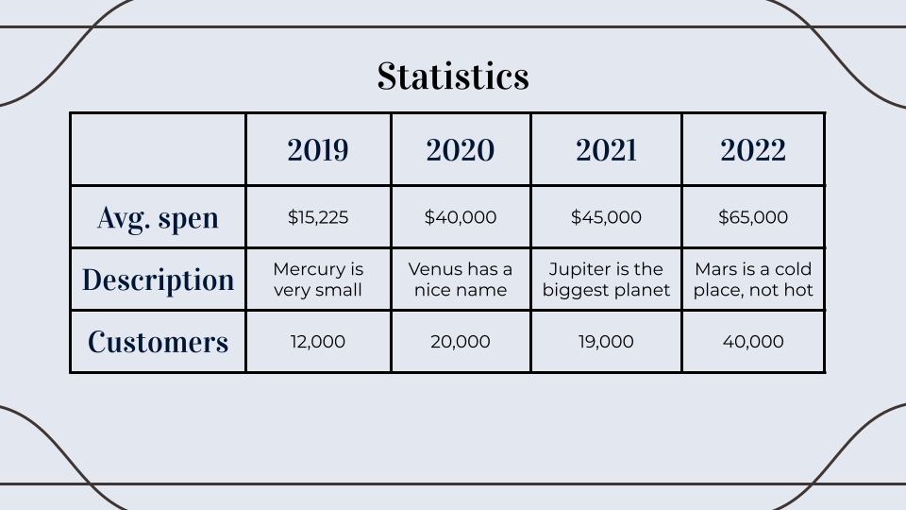
Laptop mockup
You can replace the image on the screen with your own work

Slide 57
List of references
Write your references here
Write your references here
Write your references here
Write your references here
Write your references here
Write your references here
Write your references here
Write your references here

Slide 58
Research references
Write references of books
Write references of books
Write references of books
Write references of books
Write references of books
Write references of books
Write references of books
Write references of books
Write references of internet
Write references of internet
Write references of internet
Write references of internet
Write references of internet
Write references of internet
Write references of internet
Write references of internet

Slide 59


Our team
Jenna Doe
John Smith
You can replace the image on the screen with your own
You can replace the image on the screen with your own

Slide 60



Our team
Dalila Roge
Joe Smith
Janice Clarke
You can replace the image on the screen with your own
You can replace the image on the screen with your own
You can replace the image on the screen with your own

Slide 61
Thanks
Do you have any questions?
your email@freepik.com
+91 620 421 838 yourcompany.com
Please keep this slide for attribution

Slide 62
Business icon pack

Slide 63
Alternative infographics elements

Slide 64
Alternative resources
Photos
People in business meeting high angle
Front view of people meeting over a cup of coffee
Businessman at office with laptop
Smiley redhead business woman working
Business women talking while looking
Medium shot smiley business woman

Slide 65
Alternative resources
Photos
Smiling young woman working at laptop in office
Medium shot woman with box
Medium shot business people with devices
Startups entrepreneurs discussing strategies
Close up business people at tablet
Man and woman discussing a new project
Business people discussing a new project

Slide 66
Alternative resources
Photos
Coworkers discussing a new project together
Smiley man holding project documents
Businessman respecting safety measures at the office
Young man using laptop with coffee cup
Icons
Business Icon Pack

Slide 67
Resources
Photos
Business people doing their job
People having a meeting in the office
Young co worker spending time in office
Front view woman working at office
Front view woman working as economist
Smiley woman at business meeting

Slide 68
Resources
Photos
Low angle womens team meeting
Close up on company employee smiling
Close up on young businesswoman
Low angle womens team meeting I
Blond woman sitting back and smiling with closed eyes at workplace
Happy business woman holding coffee

Slide 69
Resources
Photos
Smiley woman working in the office with papers and laptop
Side view of coworkers at the office working with laptop
Business team working together in the office with laptop
Medium shot smiley woman at work

Slide 70
Instructions for use (premium users)
As a Premium user, you can use this template without attributing Slidesgo or keeping the "Thanks" slide.
You are allowed to:
Modify this template.
Use it for both personal and commercial purposes.
Hide or delete the “Thanks” slide and the mention to Slidesgo in the credits.
Share this template in an editable format with people who are not part of your team.
You are not allowed to:
Sublicense, sell or rent this Slidesgo Template (or a modified version of this Slidesgo Template).
Distribute this Slidesgo Template (or a modified version of this Slidesgo Template) or include it in a database or in any other product or service that offers downloadable images, icons or presentations that may be subject to distribution or resale.
Use any of the elements that are part of this Slidesgo Template in an isolated and separated way from this Template.
Register any of the elements that are part of this template as a trademark or logo, or register it as a work in an intellectual property registry or similar.
For more information about editing slides, please read our FAQs or visit Slidesgo School:
https://slidesgo.com/faqs and https://slidesgo.com/slidesgo-school

Slide 71
JANUARY
FEBRUARY
MARCH
APRIL
MAY
JUNE
PHASE 1
Task 1
Task 2
PHASE 2
Task 1
Task 2
JANUARY
FEBRUARY
MARCH
APRIL
PHASE 1
Task 1
Task 2

Slide 74
...and our sets of editable icons
You can resize these icons without losing quality.
You can change the stroke and fill color; just select the icon and click on the paint bucket/pen.
In Google Slides, you can also use Flaticon’s extension, allowing you to customize and add even more icons.

Slide 75
Educational Icons
Medical Icons

Slide 76
Business Icons
Teamwork Icons

Slide 77
Nature Icons

